Slide 1
ADC/DAC
Melvin C Jose

Slide 2
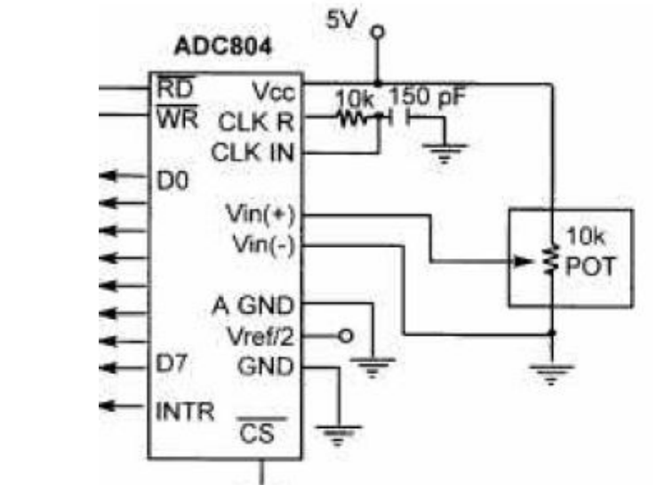
Interfacing ADC

Slide 3
Interfacing ADC
CS: chip select – must be low to access ADC chip
RD: Digital o/p becomes available when H to L pulse is applied
WR: Conversion process starts when a L to H pulse is applied
INTR: Goes low when conversion is finished
CLK IN and CLK R: CLK IN is used to connect external clock. If internal clock is used f=1/(1.1 RC)
Vin (+) and Vin (-): These are the differential analog inputs
Vcc: This is the +5 volt power supply.

Slide 4

Interfacing ADC
Vref/2: If this pin is open (not connected), the analog input voltage for the ADC0804 is in the range of 0 to 5 volts (the same as the Vcc pin).
Vref/2 is used to implement analog input voltages other than 0 to 5 V. For example, if the analog input range needs to be 0 to 4 volts, Vref/2 is connected to 2 volts.
DO-D7: DO – D7 (D7 is the MSB) are the digital data output pins step size (resolution) is the smallest change, which is (2 x Vref/2)/256 for ADC0804

Slide 5
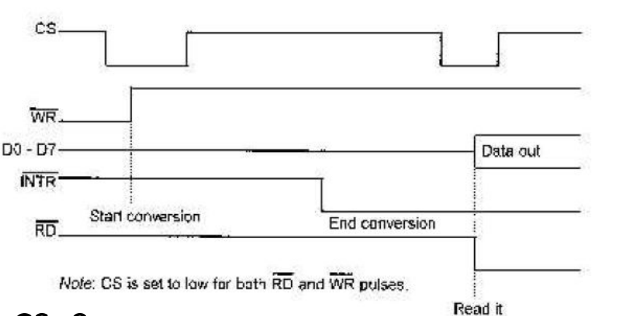
Interfacing ADC

Slide 6
Procedure for ADC interfacing
CS=0
L to H on WR
Monitor INTR.
If INTR low
make CS=0 ,
H to L on RD

Slide 7
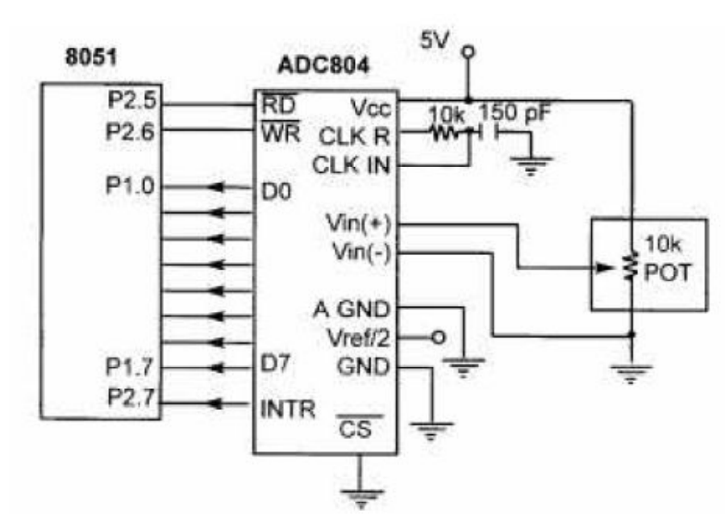
Interfacing Diagram of ADC

Slide 8
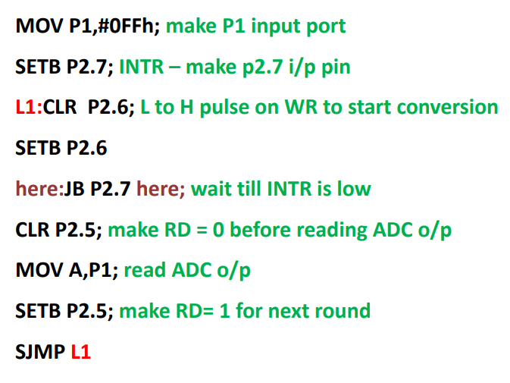
Interfacing Program of ADC

Slide 9
Interfacing Program of ADC
#include<reg51.h>
#define input P1 //Input port (read values of ADC)
Void delay(unsigned int msec );
Void adc();
Sbit wr= P3^5; // Write pin.
Sbit rd= P3^6; // Read pin.
Sbit intr= P3^4; // Interrupt pin.

Slide 10
Interfacing Program of ADC
void main()
{
input=0xff; // Declare port 1 as input port.
while(1)
{
adc();
}
}
void delay(unsigned int msec ) // Delay function
{
Int i, j ;
for(i=0;i<msec;i++)
for(j=0; j<1275; j++);
}

Slide 11
Interfacing Program of ADC
Void adc() // Reading values from ADC
wr=0;
delay(10);
wr=1;
while(intr==1);
rd=0;
A=input;
delay(10);
rd=1;
}

Slide 12
Interfacing DAC
The digital-to-analog converter (DAC) is a device used to convert digital pulses to analog signals.
DAC0808 uses the R/2R method for digital to analog conversion since it can achieve a much higher degree of precision.
The number of data bit inputs decides the resolution of the DAC since the number of analog output levels is equal to 2^{n}, where n is the number of data bit inputs.
The DAC0808 is an 8 i/p DAC which provides 256 discrete voltage (or current) levels of output.

Slide 13
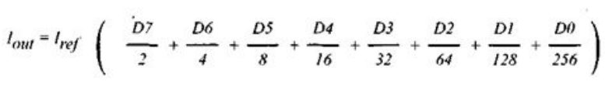
Interfacing DAC
In the MC1408 (DAC0808), the digital inputs are converted to current (I_{out}), and by connecting a resistor to the I_{out} pin, we convert the result to voltage.
The total current provided by the I_{out} pin is a function of the binary numbers at the DO – D7 inputs of the DAC0808 and the reference current (I _{ref}), and is as follows:
Where DO is the LSB, D7 is the MSB for the inputs, and I_{ref} is the input current that must be applied to pin 14. The I_{ref} current is generally set to 2.0 mA. Figure shows the generation of current reference (setting I_{ref} = 2 mA) by using the standard 5-V power supply and IK and 1.5K-ohm standard resistors. Now assuming that I_{ref} = 2 mA, if all the inputs to the DAC are high, the maximum output current is 1.99 mA

Slide 14
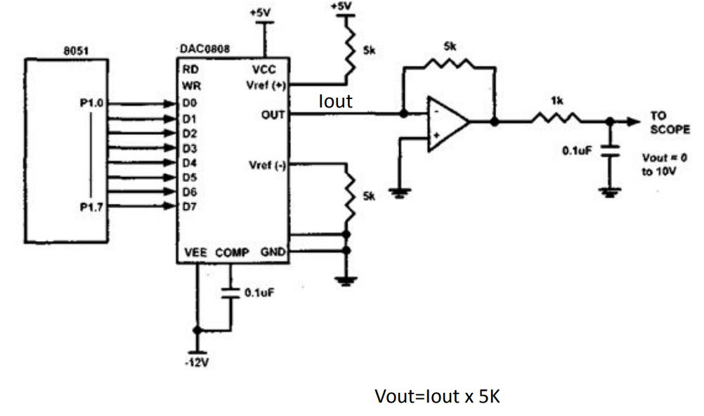
Interfacing DAC

Slide 15
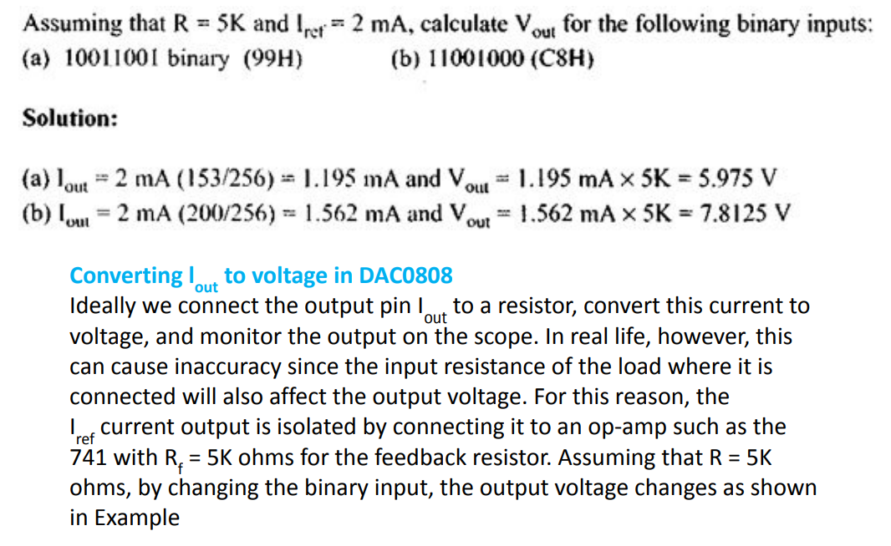
Interfacing DAC

Slide 16
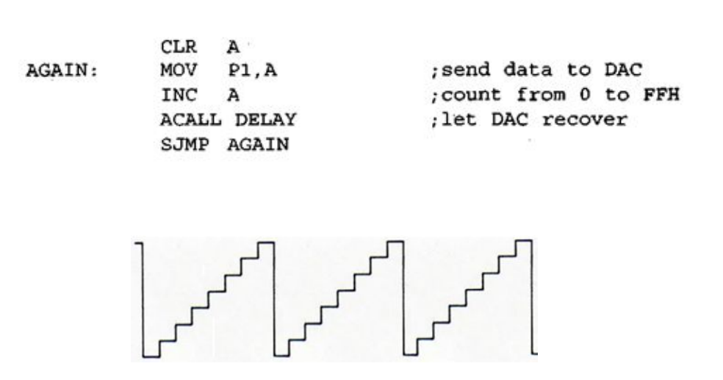
Using DAC generate a stair-step ramp

Slide 17
Using DAC generate a stair-step ramp
# include <reg51.h>
void delay(unsigned int msec )
void main(void)
unsigned char d;
while(1)
{
for(d=0x00;d<=0xFF;d++) // send values 00 to FF
{
P1=d; // one by one for positive ramp
MSDelay(100);
}
}
void delay(unsigned int msec ) // Delay function
{
Int i, j ;
for(i=0;i<msec;i++)
for(j=0; j<1275; j++);
}

Slide 18
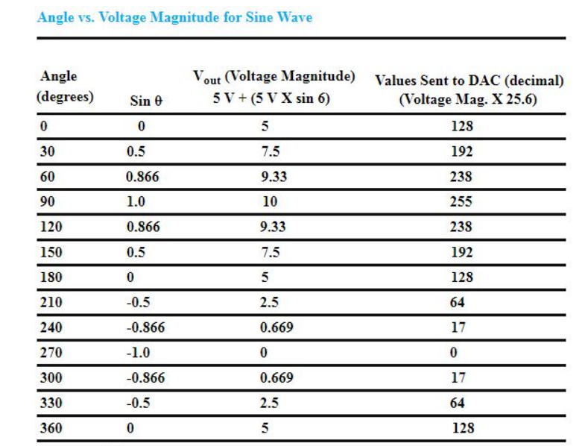
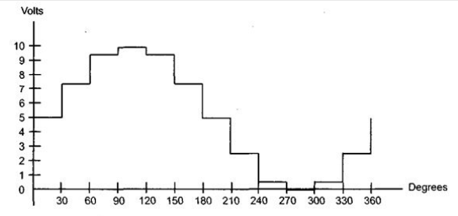
Using DAC generate a Sine Wave

Slide 19
Using DAC generate a Sine Wave
#include<reg51.h>
void main()
{
unsigned char sin_value[] = {128,192,238,255,238,192,128,64,17,0,17,64};
unsigned char i;
while(1)
{
for(i = 0; i<12; i++)
{
P0 = sin_value[i];
}
}
}

Slide 20
Using DAC generate a Square wave
# include <reg51>
void main(void)
{
while(1)
{
P1=0xFF; // first send all high to P1
MSDelay(100);
P1=0x00; // then send all low to P1
MSDelay(100);
}
}

Slide 21
Using DAC generate a Triangular wave
# include <reg51>
void main(void)
unsigned char d;
while(1)
{
for(d=0x00;d<0xFF;d++) // send values 00 to FF
{
P1=d; // one by one for positive ramp
}
for(d=0xFF;d>0x00;d--) // send values FF to 00
{
P1=d; // one by one for negative ramp
}
}

